Slide 1
Machine Learning in Data Driven Marketing – A primer on local (Large) Language Models
Andreas Karasenko

Slide 2
Goals
Motivate
The usage of local LLMs
Understand
The fundamentals
Apply
Locall LLMs to solve problems

Slide 3

Goals
Code available under https://github.com/AndreasKarasenko/presentation_10-2024
Or this QR-code …

Slide 4
Table of contents
1
Motivation
2
Fundamentals of (large) language models (LLM)
3
Getting started with local LLMs
4
Practical examples

Slide 5
Motivation
Why machine learning in marketing?
Massive amounts of customer data available
Application areas along the complete customer journey
Where is machine learning used?
Purchasing
Recommendation Systems (what product / service) Guha et al. (2021)
Upflift models (who receives coupons) Baier & Stöcker (2022)
Customer segmentation (which customers are similar) Davenport et al. (2020)
Churn and Shopping cart abandonment prediction (which customers will leave) Rausch & Derra (2020)
Customer Feedback & Care
Trend analysis & monitoring (are users satisfied)
Product optimization (what product attributes are good/bad) Salminen et al. (2022)
Service recovery (what was the pain point) Liu et al. (2019)
User experience
Eye tracking (Where do/will users look) Rump et al. (2020)
Clickstream-Analysis (How do users navigate) Koehn et al. (2020)
Virtual assistants & Chatbots Huang et al. (2023)

Slide 6
Motivation
Why machine learning in marketing?
Massive amounts of customer data available
Application areas along the complete customer journey
Where is machine learning used?
… also: market research (synthetic surveys) Arora et al. (2024)
Purchasing
Recommendation Systems (what product / service) Guha et al. (2021)
Upflift models (who receives coupons) Baier & Stöcker (2022)
Customer segmentation (which customers are similar) Davenport et al. (2020)
Churn and Shopping cart abandonment prediction (which customers will leave) Rausch & Derra (2020)
Customer Feedback & Care
Trend analysis & monitoring (are users satisfied)
Product optimization (what product attributes are good/bad) Salminen et al. (2022)
Service recovery (what was the pain point) Liu et al. (2019)
User experience
Eye tracking (Where do/will users look) Rump et al. (2020)
Clickstream-Analysis (How do users navigate) Koehn et al. (2020)
Virtual assistants & Chatbots Huang et al. (2023)

Slide 7
Motivation
Why (Large) Language Models?
Large amounts of data is unstructured Grimes (2008)
Capable of transfer learning
Are state-of-the-art for text generation
Mimic human writing / speech / art
Why not traditional approaches?
See next chapter …
Why local LLMs?
Data privacy / security
Customizability / Fine-Tuning
Availability, Performance, Latency
Avoiding vendor lock-in

Slide 8
Table of contents
1
Motivation
2
Fundamentals of (large) language models (LLM)
3
Getting started with local LLMs
4
Practical examples

Slide 9
Fundamentals
Natural Language Processing (NLP)
Applies computational techniques to interpret, manipulate, comprehend and analyse natural language (e.g. text) Amazon (A) (2024)
Computers cannot work with raw text
Transformation to numbers required → Word Embedding
Artificial Intelligence
Machine Learning
Deep Learning
Natural Language Processing

Slide 10
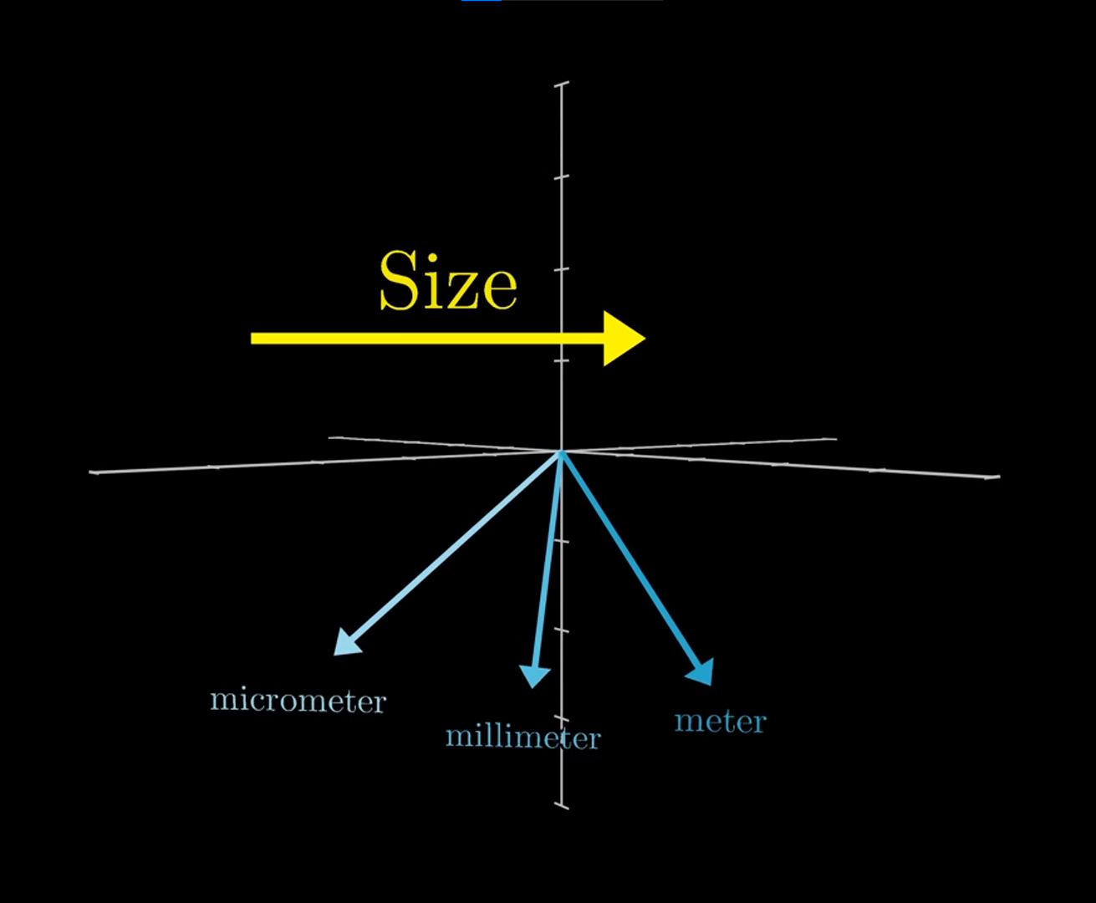
Fundamentals
Word Embeddings
NLP techniques that map individual words to numeric representations (numbers, vectors).
Embeddings simplify real-world data while (usually) preserving semantic & syntactic relationships. Amazon (B) (2024)
„Direction in the embedding space can correspond with semantic meaning“ Sanderson (2024)
Why are they important?
Reduce dimensionality
Enables / improves downstream tasks
Are the cornerstone of LLMs
Embedding types
Static embeddings
Learned static embeddings
Learned contextual embeddings (e.g. based on attention)

Slide 11
Fundamentals – Embeddings
Static Embeddings
Refers to methods that map words to vectors solely based on their occurence; they:
Transform sentences to a fixed sized vector
Disregard order
Disregard relationships
Are static
Cannot show dissimilarity
corpus = [ 'This is the first document.', 'This document is the second document.', 'And this is the third one.','Is this the first document?’, ]
Document | this | is | the | first | document | second | and | third | one
Doc 1 | 1 | 1 | 1 | 1 | 1 | 0 | 0 | 0 | 0
Doc 2 | 1 | 1 | 1 | 0 | 2 | 1 | 0 | 0 | 0
Doc 3 | 1 | 1 | 1 | 0 | 0 | 0 | 1 | 1 | 1
Doc 4 | 1 | 1 | 1 | 1 | 1 | 0 | 0 | 0 | 0

Slide 12
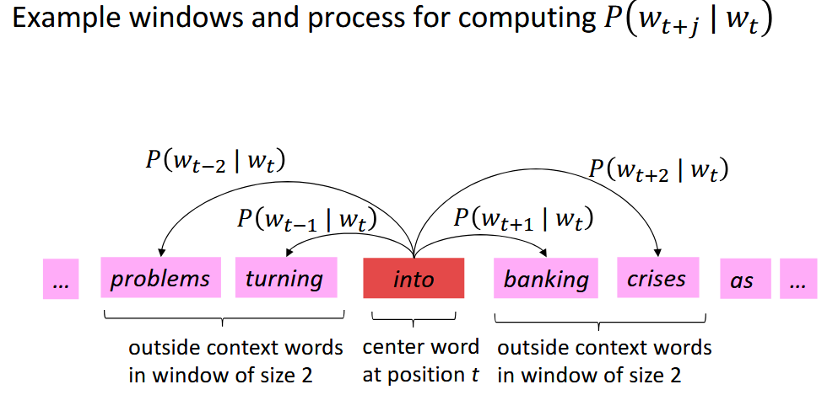
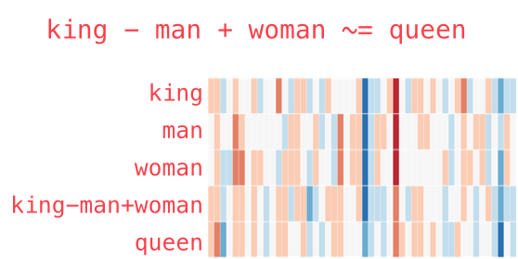
Fundamentals – Embeddings
Learned Embeddings
Similar words should have similar representations, they are „[…] characterized by the company [they keep]“ (Firth 1957)
(E.g.) Word2Vec:
transforms words to fixed-size vectors
Use similarity of words to calculate their dependent probability
Adjust until probability is maximized
Source: Stanford NLP with Deep Learning
Source: Jay Alammar – The Illustrated Word2vec

Slide 13
Fundamentals – Embeddings
Why is context relevant?
„Did you feed my mouse?“
„My computer can‘t detect the mouse“
How do we differentiate „mouse“?
Contextual Embeddings
Instead of learning word-embeddings globally, consider the local context (e.g. sentence) when calculating the vector
ELMo, ULMFiT, GPT, BERT:
Train a (large) language model on massive datasets
Learn a general task (next sentence/word prediction, masked language modeling)
Finetune to new task, or domain
Attention mechanism
Came as an answer to the inherent weakness of Recurrent Neural Networks (RNN), and Long short-term memroy (LSTM) networks – favoring more recent information. Enables contextual embeddings

Slide 14
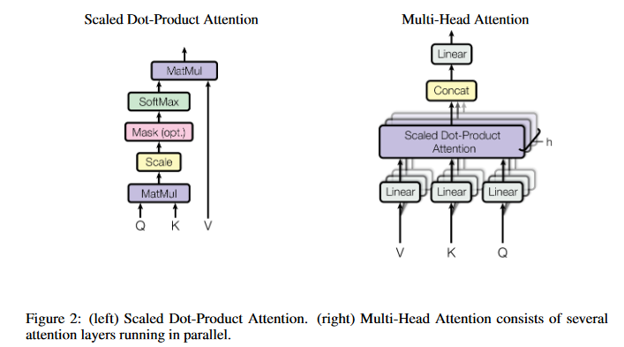

Fundamentals – Attention
(Self-)Attention
Determines the relative importance of each word in a sentence to other words in that same sentence. „Which words in a sentence are relevant for a specific word?“
Query $q_{i}=W^{Q}x_{i}$
The scaled embedding of the current word from the target
Key $k_{i}=W^{K}x_{i}$
The scaled embeddings of all values from the source
Value $v_{i}=W^{V}x_{i}$
The scaled embeddings of all values from the source
Each component contains a matrix of learnable weights $W$ that scale the embedding $x_{i}$.
$$attention\left(Q,K,V\right)=softmax\left(\frac{QK^{T}}{\sqrt{d_{k}}}\right)V$$
Source: Vaswani et al. (2017)

Slide 15
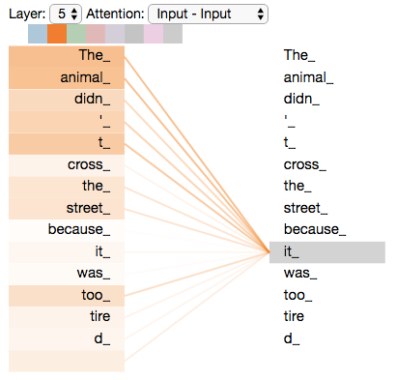
Fundamentals – Attention
“The animal didn't cross the street because it was too tired”
What attends to “it”?
Source: Jay Alammar – The illustrated transformer

Slide 16
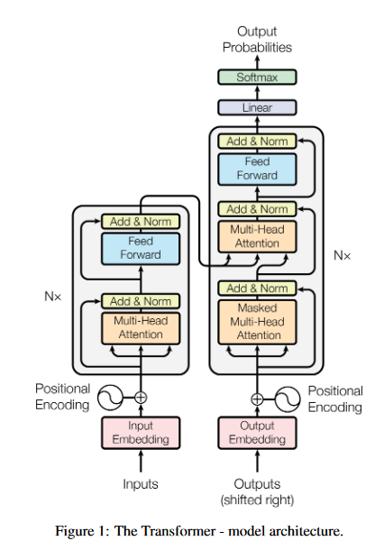
Fundamentals – Transformer
Feed-forward networks
Layer normalization
Masking and masked attention
Cross attention
…
Source: Vaswani et al. (2017)

Slide 17
Fundamentals – Additional resources
Attention, transformers and embeddings
3Blue1Brown: https://www.youtube.com/watch?v=eMlx5fFNoYc&t → Several high quality videos
Stanford: https://web.stanford.edu/class/cs224n/ → Complete course Especially: https://web.stanford.edu/class/cs224n/slides/cs224n-spr2024-lecture08-transformers.pdf

Slide 18
Table of contents
1
Motivation
2
Fundamentals of (large) language models (LLM)
3
Getting started with local LLMs
4
Practical examples

Slide 19

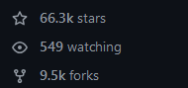






Local LLMs
Where to start?
Open-source projects offer inference engines for LLMs
Ollama
Our choice for today
KoboldCPP

Slide 20
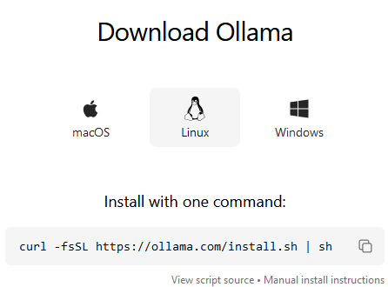
Local LLMs – Ollama
What is offered?
Extends LlamaCPP
Easy installation on Linux, MacOS, Windows
Model download & management
Interactive sessions & API server
What is needed?
(Ideally) an Nvidia GPU (8GB VRAM or more)
Enough disk space (Q4-8B models → ~4.7GB)
Preferably WSL or Linux
How do we set it up?
Setup WSL, GPU, CUDA
Execute the shell script from Ollama

Slide 21
Local LLMs – Setting up WSL
Windows Subsystem for Linux (WSL)
Runs a lightweight virtualized Linux kernel
Allows to run any Linux OS without dual booting / full VMs
Can be used in parallel with Windows
Supports newer versions of Tensorflow (v>2.10)
Why not Windows native?
Tensorflow is no longer supported after 2.10
Easier to debug

Slide 22
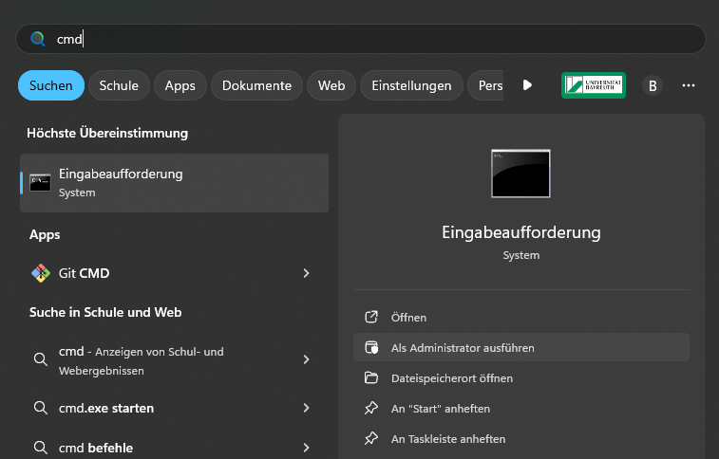
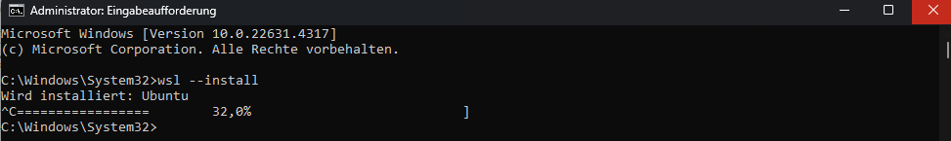

Local LLMs – Setting up WSL
Taken from the original page: Link
Check prerequsites in the link
Open PowerShell / CMD as admin
Type `wsl --install` in the terminal. Automatically installs Ubuntu in a Long Time Support (LTS) version alternative: `wsl --install -d Ubuntu-24.04`
Create a user + passwort in Ubuntu.
Check the version: `wsl -l -v` → VERSION 2

Slide 23
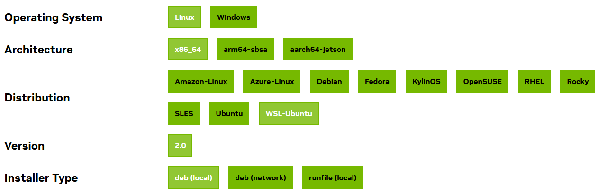
Local LLMs – Setting up CUDA
Compute Unified Device Architecture (CUDA - see also here)
Provides tools and interfaces for programmers
Runs code on the GPU in parallel
Highly relevant for the AI boom
WSL 2 can use drivers installed under Windows
Installation:
Get the Windows drivers (Nvidia RTX Experience or manual install)
Open a WSL terminal
sudo apt-key del 7fa2af80
Type in the commands found here

Slide 24
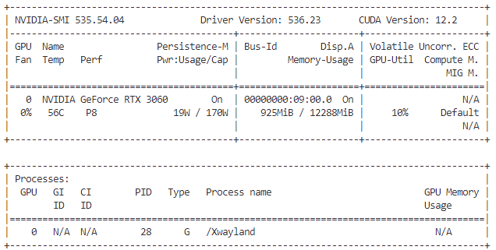
Local LLMs – Setting up CUDA
Check whether the GPU is recognized
nvidia-smi
python –c „import tensorflow as tf; tf.test.is_gpu_available()“
Make sure you can see your graphics card.
Now you can use your GPU for Tensorflow etc.

Slide 25
Local LLMs – Ollama basic usage
Model management
Manage / start the server
export OLLAMA_MAX_LOADED_MODELS=2 → max number of loaded models
export OLLAMA_NUM_PARALLEL=2 → max number of parallel tasks
ollama serve → start the server
Download models
ollama pull <model> ollama pull llama3.1 ollama pull llama3.1:70b
Remove models
ollama rm llama3.1:70b

Slide 26
Local LLMs – Ollama basic usage
Model usage
Run an interactive session
ollama run llama3.1 Then simply type as with ChatGPT
Use via API
curl http://localhost:11434/api/generate -d '{ "model": "llama3.2", "prompt": "Why is the sky blue?"}‘
Use via Python libraries
Ollama-Python (official SDK)
Scikit-Ollama

Slide 27
Table of contents
1
Motivation
2
Fundamentals of (large) language models (LLM)
3
Getting started with local LLMs
4
Practical examples

Slide 28






Practical examples
Text & Document Classification
Retrieval Augmented Generation
Positive
Reviews
User
Query
Generation
Negative
Retrieval
DB
LLM

Slide 29
Practical examples
Text Classification
Task description: Given a set of texts (e.g. user reviews), identify the most likely class (e.g. positive / negative sentiment)
Traditional solution: Train a machine learning model (Naive Bayes, Random Forest, LSTM, BERT) on large amounts of pre-labeled data
- Resource efficient (time, size, cost)
- Easy customization / iteration
- Quick inference
- Very high performance
- Interpretable (LIME, SHAP)
- Requires pre-labelled data
- Low generalization
→ Bound to domain
→ Bound to target range
- Poor performance in data sparse setting
- (Complex feature engineering)
More detailed discussions: Hartmann et al. 2019; Hartmann et al. 2023; Alantari et al. 2023; Krugmann & Hartmann 2024

Slide 30
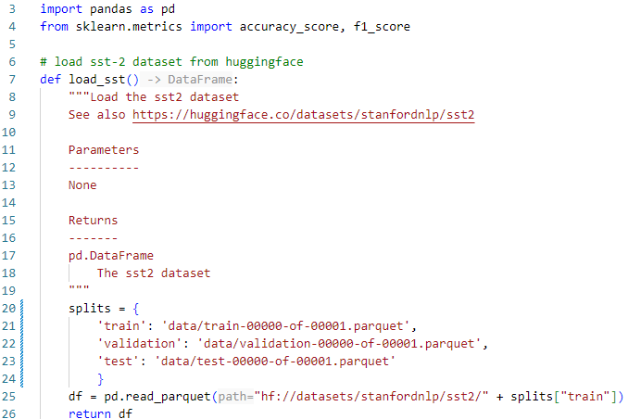
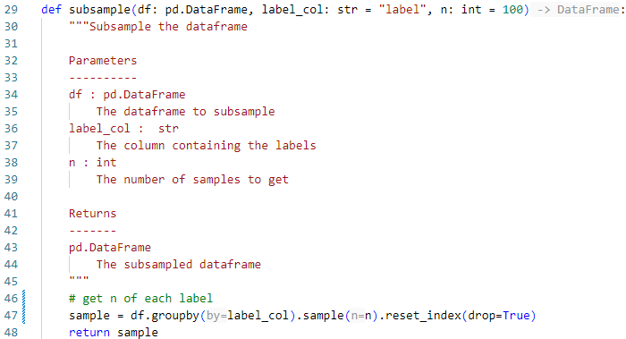
Practical examples
Text Classification – Dataset
Stanford Sentiment Treebank (SST-2):
Standard dataset commonly used for model comparisons
Binary sentiment from movie reviews (3 human annotators)
Training: 67.3k; Validation: 872; Test: 1.82k
Setup (see also Github)
Only use 100 positive, 100 negative

Slide 31
Practical examples
Text Classification
Models used:
Gemma2:9b
Siebert – RoBERTA-large fine-tuned model for binary sentiment
More detailed discussions: Hartmann et al. 2019; Hartmann et al. 2023; Alantari et al. 2023; Krugmann & Hartmann 2024

Slide 32
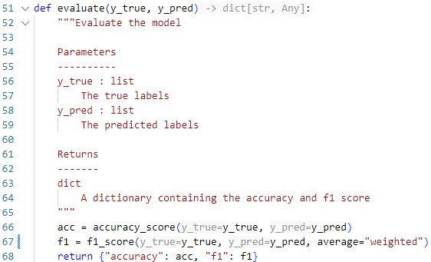
Practical examples
Text Classification – Zero-Shot Classification
Approach:
Classify 100 random positive and negative texts
Evaluate prompting strategies (simple vs guided prompt)
Metrics:
Accuracy
Weighted F1-score

Slide 33
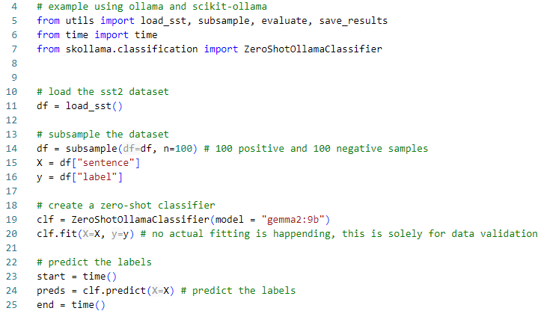
Practical examples
Text Classification – Zero-Shot Classification
Overview:
Similar to Scikit-Learn‘s API
Classifier only needs model name from Ollama
Consider: multiprocessing, prompting text

Slide 34
Practical examples
Text Classification – Results part 1
Results Zero-Shot:
Simple setup: Accuracy: 0.51, F1: 0.50995099509951, Duration: 95.85554194450378 seconds
Using multiprocessing: Accuracy: 0.525, F1: 0.5249881247031176, Duration: 56.656551122665405 seconds
Using guided prompts: Accuracy: 0.88, F1: 0.87998799879988, Duration: 176.98100304603577 seconds

Slide 35
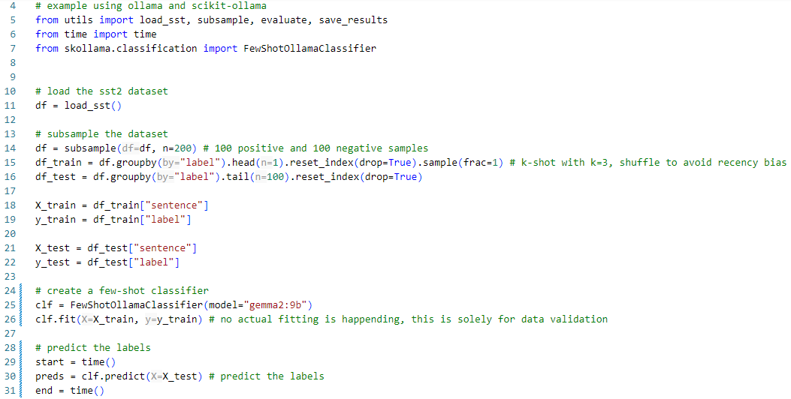
Practical examples
Text Classification – Few-Shot Classification
Overview:
Similar to Zero-Shot
Additionally requires training samples
All items in train will be used as samples
Subsample if „too many“ samples are available!
Repeat for prompting text and number of samples

Slide 36
Practical examples
Text Classification – Results part 2
Results Zero-Shot:
Simple setup: Accuracy: 0.51, F1: 0.50995099509951, Duration: 95.85554194450378 seconds
Using multiprocessing: Accuracy: 0.525, F1: 0.5249881247031176, Duration: 56.656551122665405 seconds
Using guided prompts: Accuracy: 0.88, F1: 0.87998799879988, Duration: 176.98100304603577 seconds
Results Few-Shot:
Simple text, 1 sample: Accuracy: 0.42, F1: 0.41289604210952524, Duration: 89.68885946273804 seconds
Simple text, 3 samples: Accuracy: 0.525, F1: 0.5249881247031176, Duration: 48.346925020217896 seconds
Guided text, 3 samples: Accuracy: 0.925, F1: 0.9249080123150859, Duration: 155.65270328521729 seconds

Slide 37
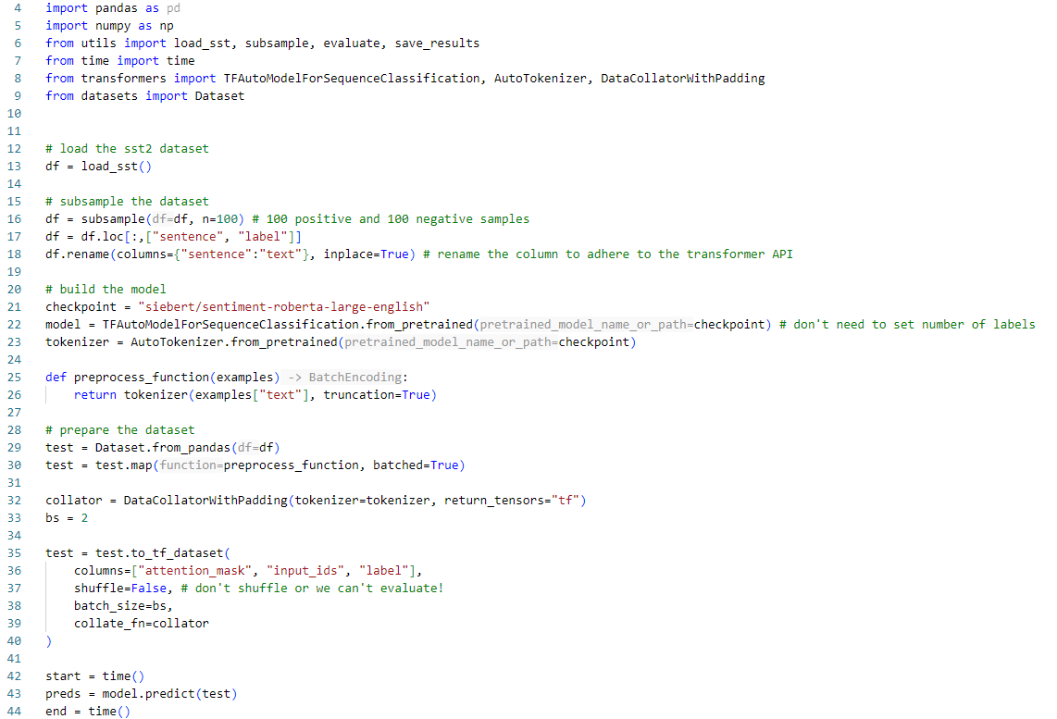
Practical examples
Text Classification – Fine-tuned transformer
Overview:
Using Huggingface and a model trained by Hartmann et al. 2023.

Slide 38
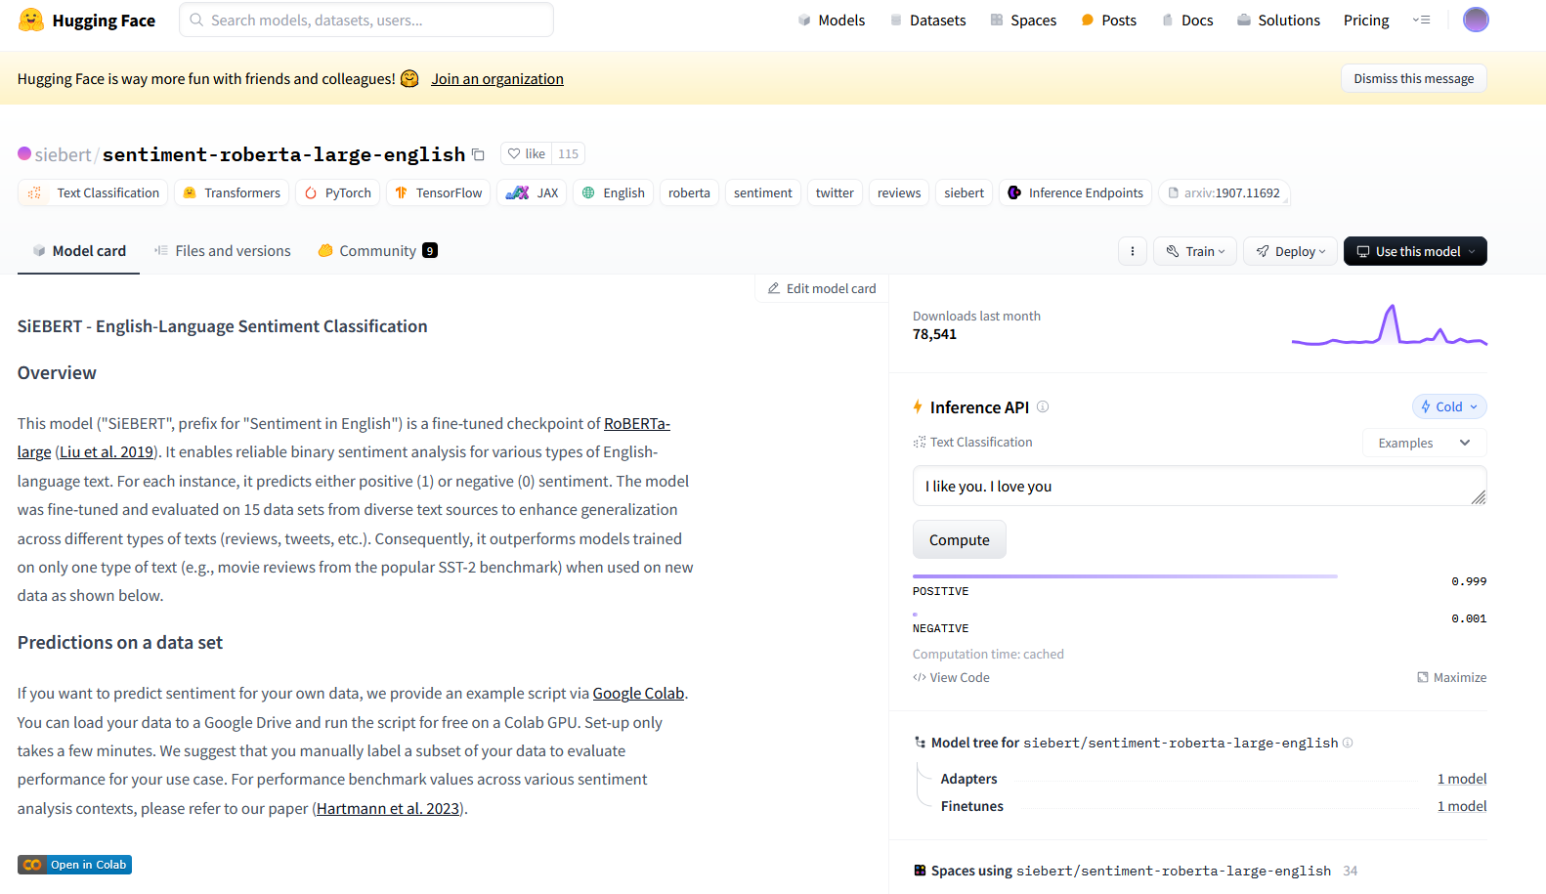
Practical examples
Text Classification – Fine-tuned transformer

Slide 39
Practical examples
Text Classification – Fine-tuned transformer
Overview:
Using Huggingface and a model trained by Hartmann et al. 2023.

Slide 40
Practical examples
Text Classification – Results part 3
Results Zero-Shot:
Simple setup: Accuracy: 0.51, F1: 0.50995099509951, Duration: 95.85554194450378 seconds
Using multiprocessing: Accuracy: 0.525, F1: 0.5249881247031176, Duration: 56.656551122665405 seconds
Using guided prompts: Accuracy: 0.88, F1: 0.87998799879988, Duration: 176.98100304603577 seconds
Results Few-Shot:
Simple text, 1 sample: Accuracy: 0.42, F1: 0.41289604210952524, Duration: 89.68885946273804 seconds
Simple text, 3 samples: Accuracy: 0.525, F1: 0.5249881247031176, Duration: 48.346925020217896 seconds
Guided text, 3 samples: Accuracy: 0.925, F1: 0.9249080123150859, Duration: 155.65270328521729 seconds
Results Fine-Tune:
Simple predict: Accuracy: 0.91, F1: 0.9099639855942376, Duration: 45.974767446517944 seconds

Slide 41
Practical examples
Text Classification – Recap and outlook
Summary:
LLMs can be used to classify texts
Open-source libraries make interfacing comparatively easy
Pros
Requires little machine learning knowledge
No fine-tuning
Adaptable
Low data requirements
Cons
Significantly larger than alternatives
Significantly slower
Significantly harder to setup
Prone to hallucinations
Likely not useful in complex settings (see e.g. SetFit)
Again, see also: Hartmann et al. 2019; Hartmann et al. 2023; Alantari et al. 2023; Krugmann & Hartmann 2024

Slide 42
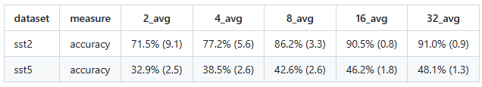
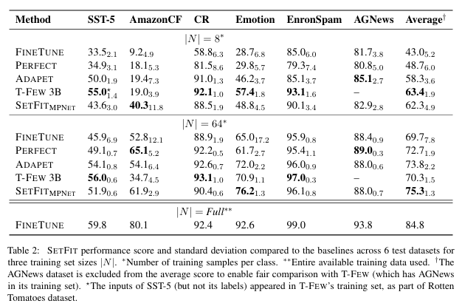
Practical examples
Text Classification – Recap and outlook

Slide 43
Practical examples
Retrieval augmented generation
Task description: 1. Construct an external knowledge source contaning easy to access / query information 2. Given a user query, find all relevant text-snippets /-documents, then generate an answer based on the retrieved information
General applications:
Document summary
Question and answer (Q&A)
Data:
Any text data, or parseable document
We use the article by Sarstedt et al. 2024 on LLMs for synthetic surveys

Slide 44
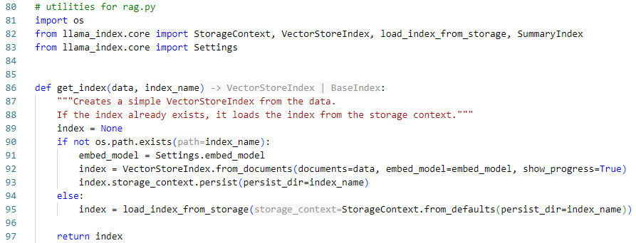
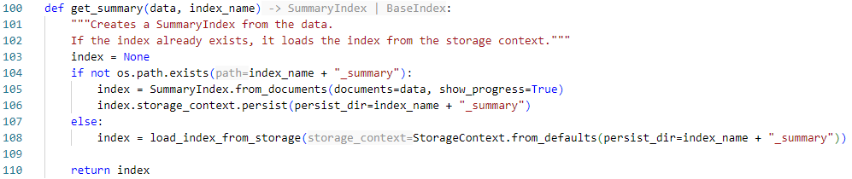
Practical examples
Retrieval augmented generation – Setup

Slide 45
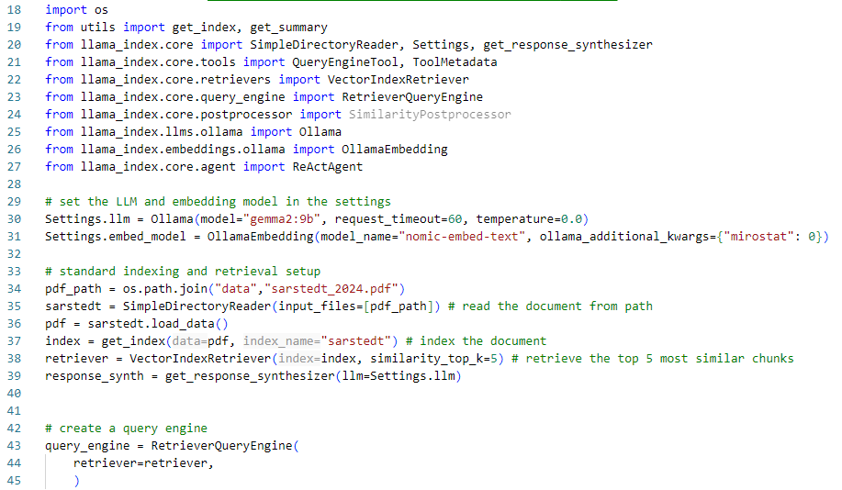
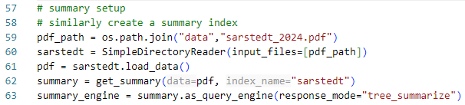
Practical examples
Retrieval augmented generation – Creating several retrieval engines
query_engine: simple matching using the 5 most similar text chunks.
summary_engine: Creates a summary index from the document.

Slide 46
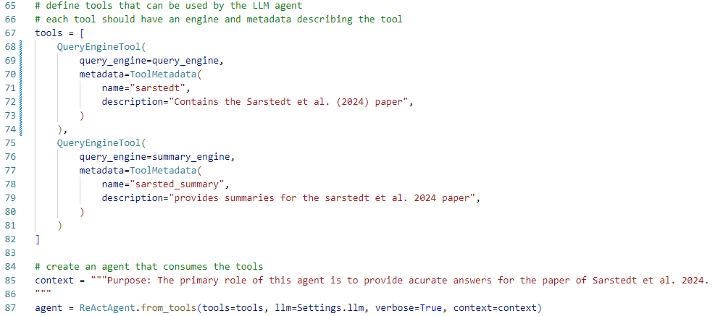
Practical examples
Retrieval augmented generation – Building tools for the LLM

Slide 47
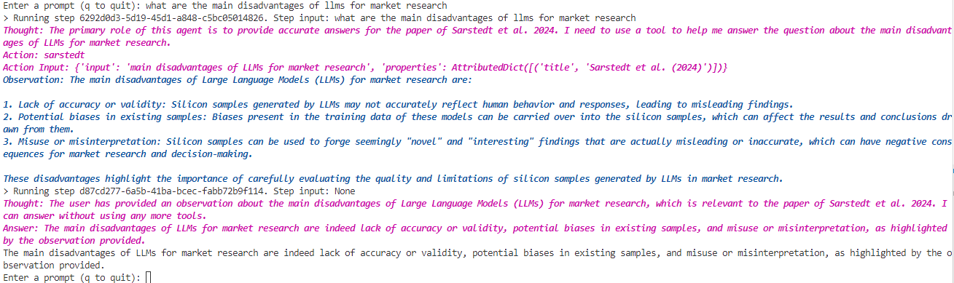
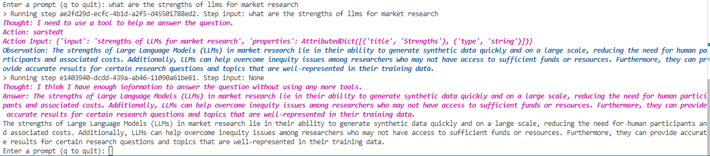
Practical examples
Retrieval augmented generation – Asking some questions

Slide 48
Practical examples
Retrieval augmented generation – Comparing to actual paper …
Weaknesses:
„One major cost discussed in this article concerns the lack of accuracy (or validity) that may turn silicon samples on a grand scale into ‘silly samples’ …“ p. 1264
“… or worse be misused to forge seemingly “novel”and “interesting,”but ultimately misleading findings.” p. 1264
„Another cost concerns potential biases in existing samples” p. 1264
Strengths:
„Silicon samples hold considerable promise for consumer research as a means to provide human‐like data quickly and on a large scale…“ p. 1266
“Benefits include immense cost and time savings, thereby overcoming inequity issues among researchers.” p. 1264
“In this respect, an established area of research that is well‐represented in the training data (e.g., product and service evaluations) may result in more accurate results” p. 1264

Slide 49
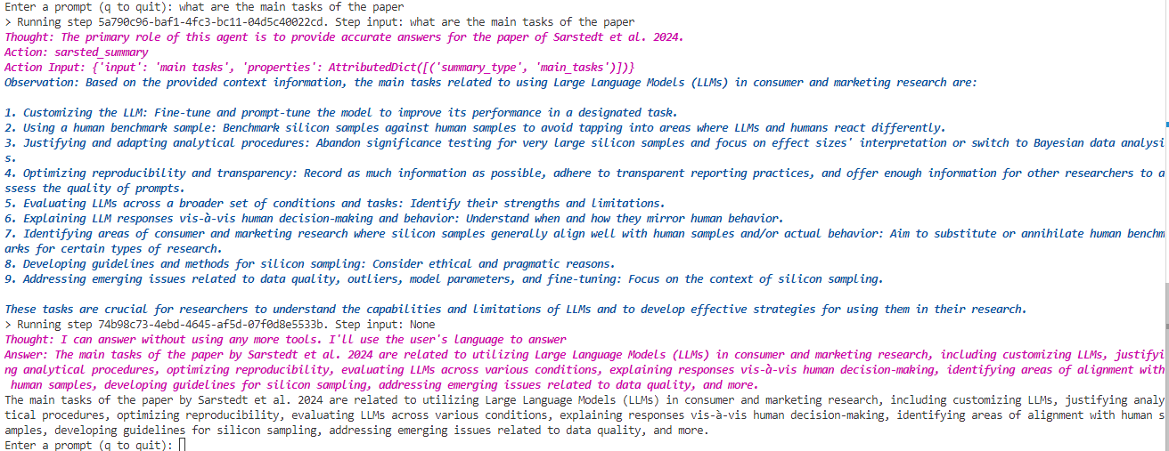
Practical examples
Retrieval augmented generation – Using the summary index

Slide 50
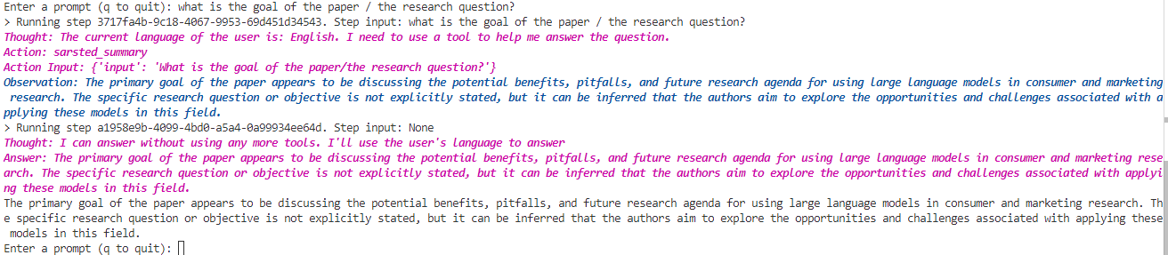
Practical examples
Retrieval augmented generation – Comparing to actual paper …
Main tasks according to LLM:
Retrieved most of chapter 3 „Recommendations concerning the use of silicon samples“ p. 1256
Summarized main points of sub-chapters 3.2.2 – 3.2.6 | p. 1261 – p. 1263
Also considered many aspects of chapter 4 „The way forward“ p.1264
→ Misunderstood the question:
Phrasing is incredibly important
However
None of the points are hallucinated
Internally consistent
A better prompt retrieves the correct information …

Slide 51
Practical examples
Retrieval augmented generation– Recap and outlook
Summary:
LLMs can be used to answer questions about a scientific paper
Answers are often different between reruns
Pros
Allows for more interactive retrieval of information
Can parse the document faster than humans
Adaptable
Cons
Prone to hallucination
May disregard instructions
May retrieve „irrelevant“ context
Requires significant customization

Slide 52
Practical examples
Overall Summary
LLMs can be used in many settings, local and open-source models provide competitive alternatives to online and closed-source proprietary solutions
Pros
Incredibly versatile
Open up new possibilities
Can be very accurate
Cons
Prone to hallucination
Requires strong & specialized hardware
Black-Box
Restricted to „common“ themes (see Sarstedt et al. 2024)
Additional tools to consider
Vector databases (pgvector, pineconce, weaviate) for storing embeddings
Web interfaces for better user experience (openwebui)
Web frameworks for custom builds (fastapi, streamlit)
Alternative data frameworks to Llamaindex (langchain)

Slide 53
References
Guha et al. 2021 – „How artificial intelligence will affect the future of retailing”, Journal of Retailing, https://doi.org/10.1016/j.jretai.2021.01.005
Davenport et al. 2020 – „How artificial intelligence will change the future of marketing”, Journal of the Academy of Marketing Science , https://rdcu.be/dXLML
Baier & Stöcker 2022 – „Profit uplift modeling for direct marketing campaigns: approaches and applications for online shops “, Journal of Business Economics, https://link.springer.com/article/10.1007/s11573-021-01068-3
Rausch & Derra 2020 – „Predicting online shopping cart abandonment with machine learning approaches “, International Journal of Market Research, https://doi.org/10.1177/1470785320972526
Salminen et al. 2022 – „Detecting Pain Points from User-Generated Social Media Posts Using Machine Learning”, Journal of Interactive Marketing, https://doi.org/10.1177/10949968221095556
Liu et al. 2019 – „Identifying individual expectations in service recovery through natural language processing and machine learning”, Expert Systems with Applications, https://doi.org/10.1016/j.eswa.2019.04.063
Rumpf et al. 2020 – „Predicting consumer gaze hits: A simulation model of visual attention to dynamic marketing stimuli”, Journal of Business Research, https://doi.org/10.1016/j.jbusres.2019.03.034
Huan et al. 2023 – “The Caring Machine: Feeling AI for Customer Care”, Journal of Marketing, https://doi.org/10.1177/00222429231224748
Grimes 2008 – “Unstructured data and the 80 percent rule,” Clarabridge BridgePoints, http://breakthroughanalysis.com/2008/08/01/unstructured-data-and-the-80-percent-rule/
Amazon (A) 2024 – “What is Natural Language Processing (NLP)?”, AWS, https://aws.amazon.com/what-is/nlp/?nc1=h_ls
Amazon (B) 2024 – “What are Embeddings in Machine Learning?”, AWS, https://aws.amazon.com/what-is/embeddings-in-machine-learning/
Vaswani et al. 2017 – “Attention is all you need”, Advances in Neural Information Processing Systems, https://user.phil.hhu.de/~cwurm/wp-content/uploads/2020/01/7181-attention-is-all-you-need.pdf
Arora et al. 2024 – “EXPRESS: AI-Human Hybrids for Marketing Research: Leveraging LLMs as Collaborators.”, Journal of Marketing, https://doi.org/10.1177/00222429241276529
More detailed discussions: Hartmann et al. 2019; Hartmann et al. 2023; Alantari et al. 2023; Krugmann & Hartmann 2024

Slide 54
References
Sanderson (3Blue1Brown 2024 – „Visualizing Attention, a Transformer's Heart | Chapter 6, Deep Learning”, Youtube, https://www.youtube.com/watch?v=eMlx5fFNoYc
More detailed discussions: Hartmann et al. 2019; Hartmann et al. 2023; Alantari et al. 2023; Krugmann & Hartmann 2024

